Slide 1


International University
MICRO-PROCESSING SYSTEM
Lecture 2:
Basic AVR Programming in C
Vo Minh Thanh, M.Eng
School Of Electrical Engineering

Slide 2
OBJECTIVES
Upon completion of this Lecture, you will be able to:
Understand AVR Microcontroller Architecture
Examine C data types for the AVR
Code C programs for time delay and 1/0 operations
Code C programs for 1/0 bit manipulation
Code C programs for logic and arithmetic operations
Code C programs for ASCII and BCD data conversion
Code C programs for binary (hex) to decimal conversion
Code C programs for data serialization
Code C programs for EEPROM access

Slide 3
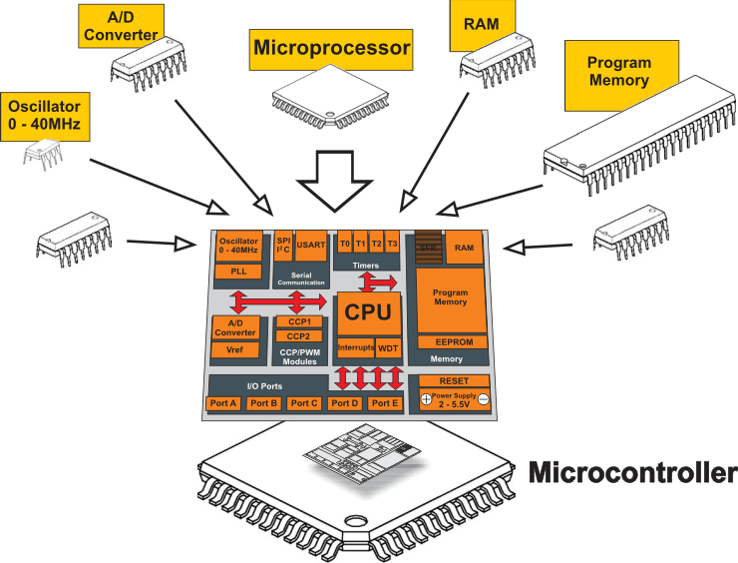
AVR Architecture

Slide 4
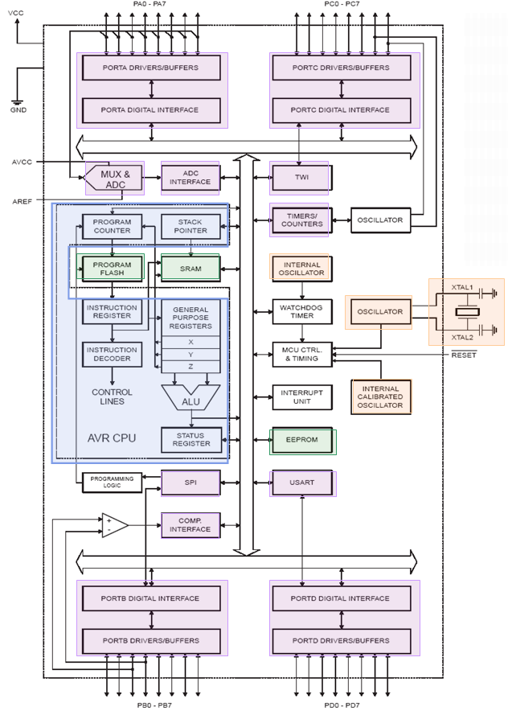
ATMega32 Architecture
Native data size is 8 bits (1 byte).
Uses 16-bit data addressing allowing it to address 2¹⁶ = 65536 unique addresses.
Has three separate on-chip memories
2KB SRAM: 8 bits wide used to store data
1KB EEPROM: 8 bits wide used for persistent data storage
32KB Flash: 16 bits wide used to store program code
I/O ports A-D
Digital input/output
Analog input
Serial/Parallel
Pulse accumulator

Slide 5
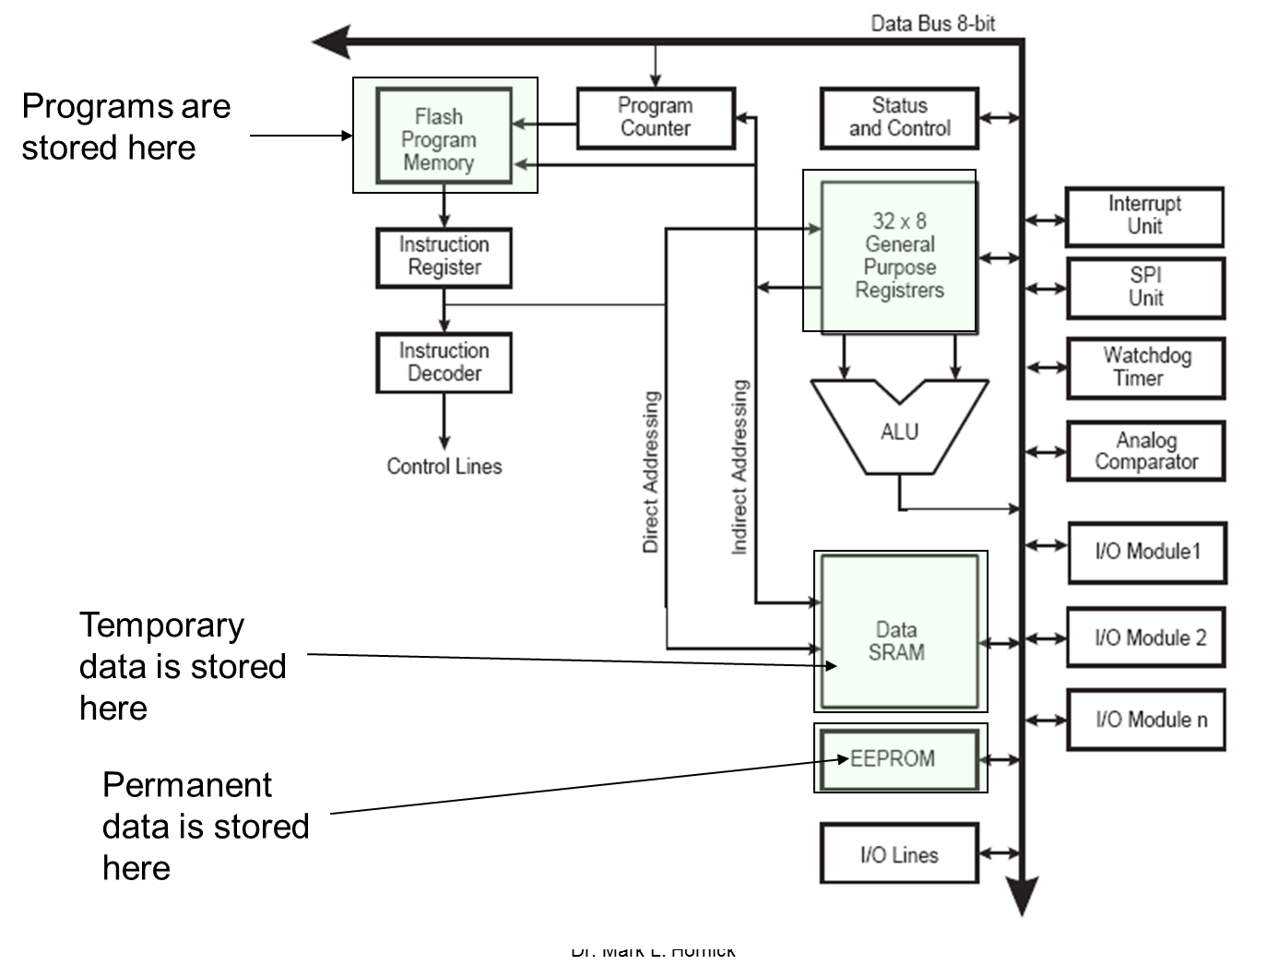
ATMega32 Programmer Model: Memory
2KB SRAM
For temporary data storage
Memory is lost when power is shut off (volatile)
Fast read and write
1KB EEPROM
For persistent data storage
Memory contents are retained when power is off (non-volatile)
Fast read; slow write
Can write individual bytes
32KB Flash Program Memory
Used to store program code
Memory contents retained when power is off (non-volatile)
Fast to read; slow to write
Can only write entire “blocks” of memory at a time
organized in 16-bit words (16KWords)

Slide 6
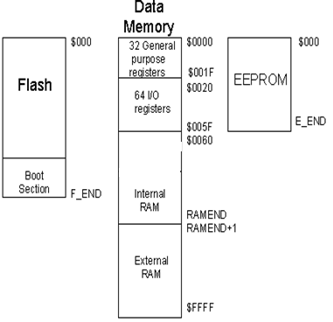
ATMega32 Programmer Model: Memory
AVR microcontrollers are Harvard architecture. This means, that in this architecture are separate memory types (program memory and data memory) connected with distinct buses. Such memory architecture allows processor to access program memory and data memory at the same time. This increases performance of MCU comparing to CISC architecture, where CPU uses same bus for accessing program memory and data memory.
Each memory type has its own address space:
Type | Flash |  | RAM |  | EEPROM
 | F_END | Size, kB | RAMEND | Size, kB | E_END | Size, kB
Atmega8 | $0FFF | 8 | $045F | 1 | $1FF | 0.5
Atmega32 | $3FFF | 32 | $085F | 2 | $3FF | 1
Atmega64 | $7FFF | 64 | $10FF | 4 | $7FF | 2
Atmega128 | $FFFF | 128 | $10FF | 4 | $FFF | 4

Slide 7
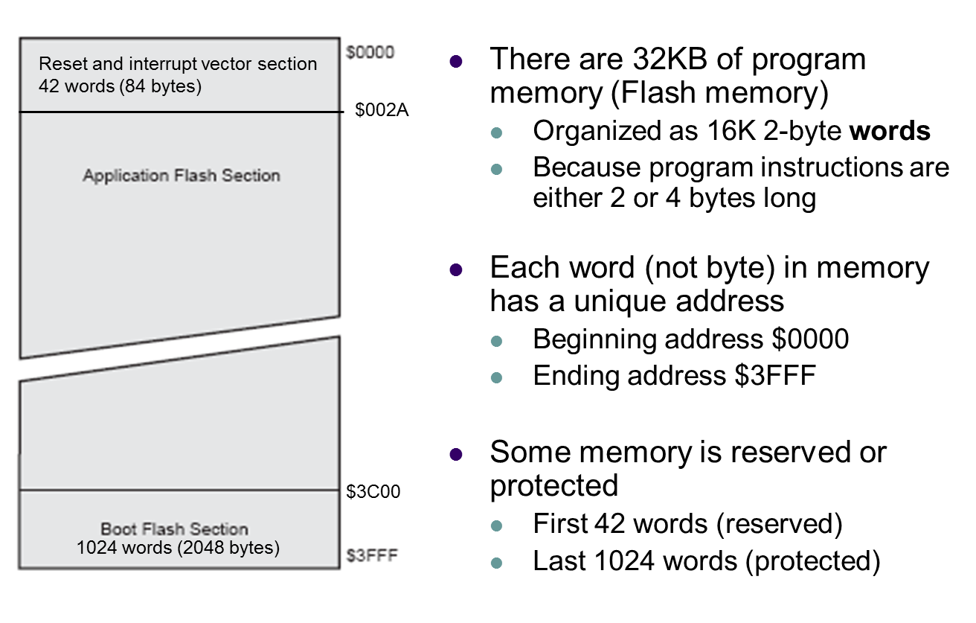
ATMega32 Programmer Model: Program Memory
Flash Memory Layout

Slide 8
Why program the AVR in C?
The following are some of the major reasons for writing programs in C instead of Assembly:
1. It is easier and less time consuming to write in C than
in Assembly.
2. C is easier to modify and update.
3. You can use code available in function libraries.
4. C code is portable to other microcontrollers with little
or no modification

Slide 9
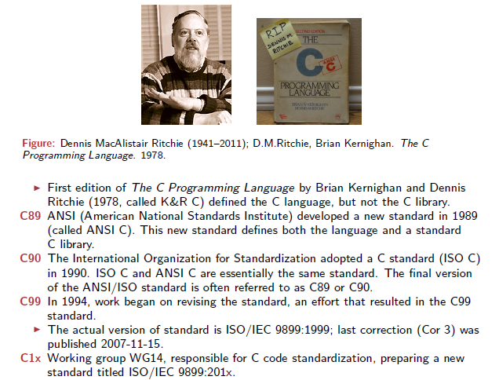
C language

Slide 10
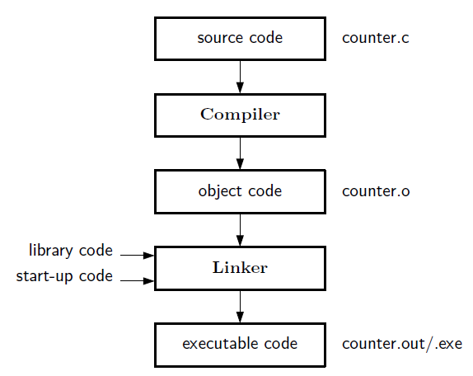
Compilation of C language source code
Download to MCU
Linux
Windows
counter.hex

Slide 11
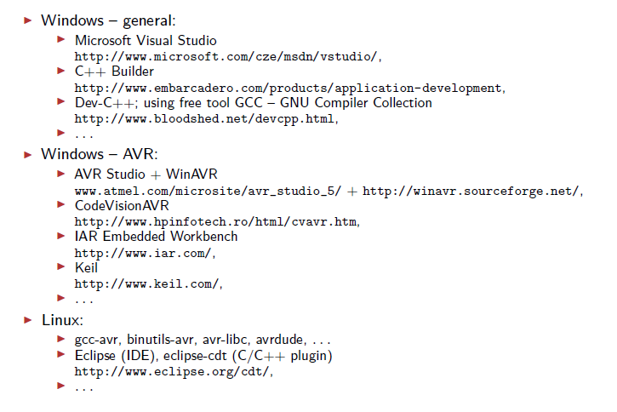
Software development tools

Slide 12
C compilers
Several third-party companies develop C compilers for the AVR microcontroller.
Our goal is not to recommend one over another, but to provide you with the fundamentals of C programming for the AVR.
You can use the compiler of your choice for the chapter examples and programs.
For this book we have chosen AVR GCC compiler to integrate with AVR Studio. At the time of the writing of this book AVR GCC and AVR Studio are available as a free download from the Web.

Slide 13
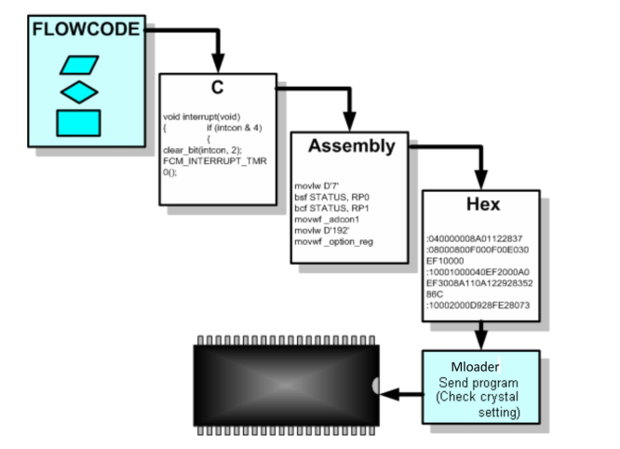
Programming Language

Slide 14
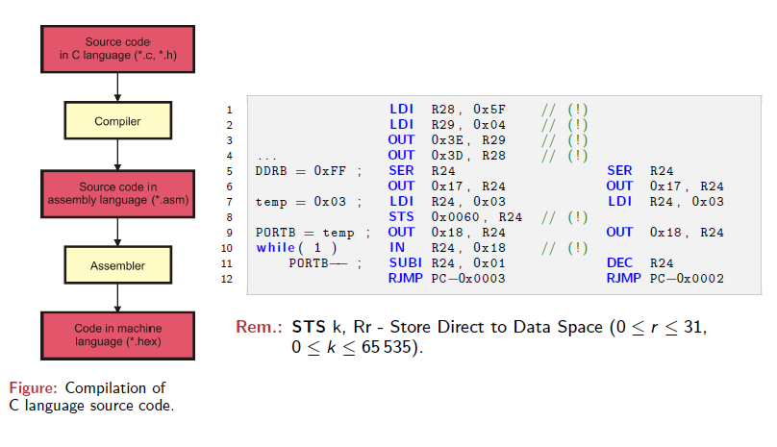
Source Code Compilation

Slide 15
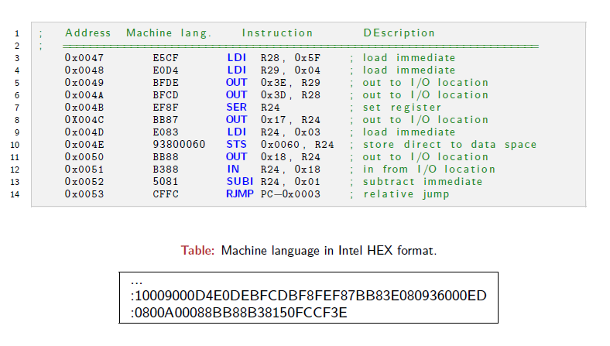
Assembling the application

Slide 16
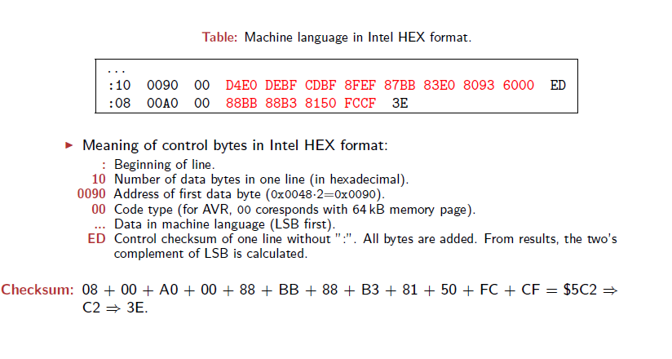
Intel HEX Format Description

Slide 17
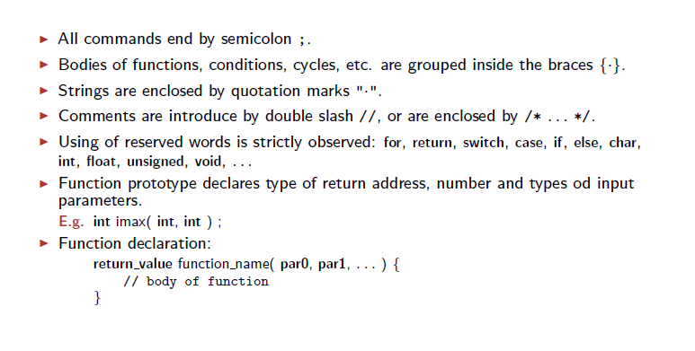
Basic Principles in C Language Programming

Slide 18
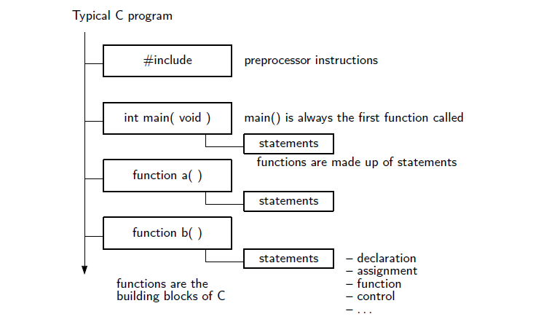
Structure of C Code

Slide 19
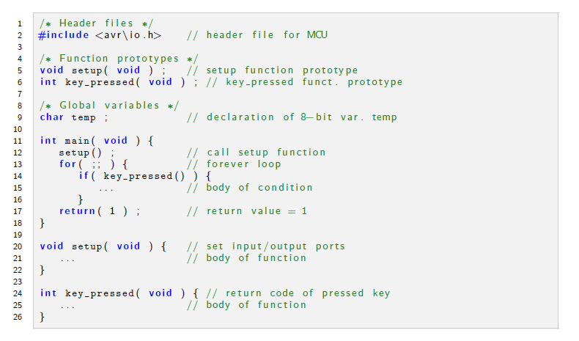
Function Prototype

Slide 20
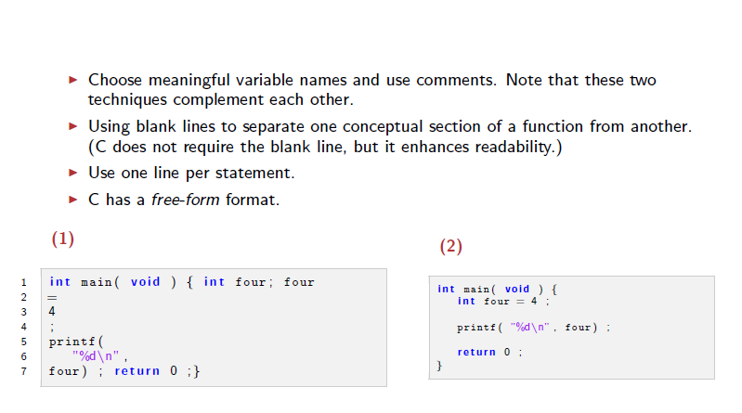
Tips on Making Programs Readable

Slide 21
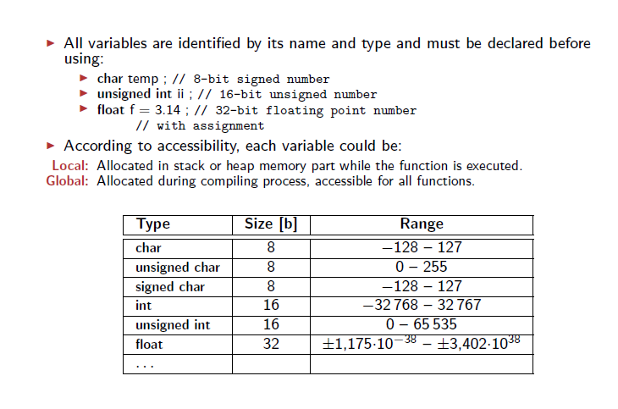
Variables

Slide 22
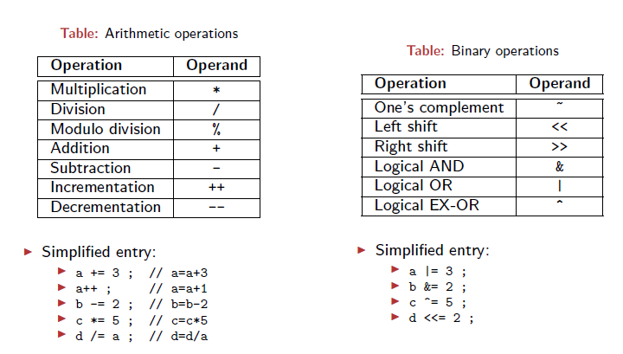
Arithmetic and Binary Operations

Slide 23
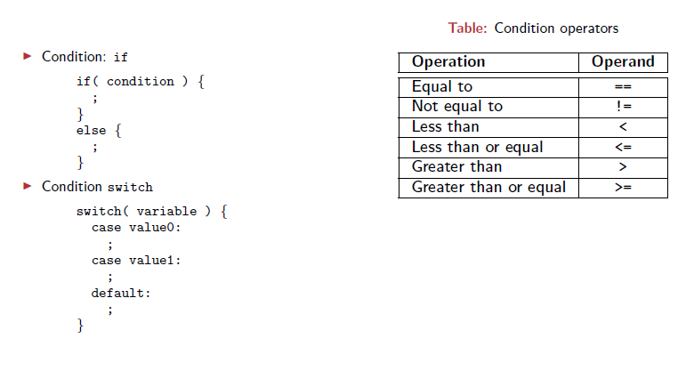
Condition

Slide 24
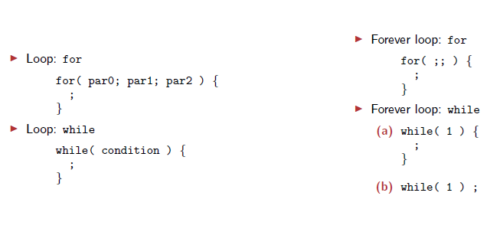
Loops

Slide 25
Outline
Data types and time delays in C
I/O programming in C
Logic operations in C
Data conversion programs in C
Data serialization in C
Memory allocation in C

Slide 26
C data types for the AVR C
One of the goals of AVR programmers is to create smaller hex files, so it is worthwhile to re-examine C data types.
A good understanding of C data types for the AVR can help programmers to create smaller hex files.
In this section we focus on the specific C data types that are most common and widely used in AVR C compilers.
Table 7 -1 shows data types and sizes, but these may vary from one compiler to another.

Slide 27
Table 7-1. Some Data Types Widely Used by C Compilers
Data Type | Size in bits | Data Range/Usage
unsigned char | 8 | 0 to 255
char | 8 | -128 to +127
unsigned int | 16 | 0 to 65,535
int | 16 | -32,768 to +32,767
unsigned long | 32 | 0 to 4,294,967,295
long | 32 | -2,147,483,648 to +2,147,483,648
float | 32 | ±1.175e-38 to ±3.402e38
double | 32 | ±1.175e-38 to ±3.402e3

Slide 28
Unsigned char
The unsigned char is an 8-bit data type that takes a value in the range of 0-255 (00-FFH). It is one of the most widely used data types for the 8-bit AVR.
In declaring variables, we must pay careful attention to the size of the data and try to use unsigned char instead of int if possible for saving more memory space.
Remember that C compilers use the signed char as the default unless we put the keyword unsigned in front of the char (see Example 7-1). We can also use the unsigned char data type for a string of ASCII characters, including extended ASCII characters. Example 7-2 shows a string of ASCII characters. See Example 7-3 for toggling a port 200 times.

Slide 29
Example 7-1
Write an AVR C program to send values 00-FF to Port B.
Solution:
#include <avr/io.h> //standard AVR header
#include <avr/delay.h> //standard AVR header
int main(void)
{
unsigned char z;
DDRB = 0xFF; //PORTB is output
for (z = 0; z < 255; z++)
PORTB = z;
_delay_ms(1000);
return 0;
}
//Notice that the program never exits the for loop because if you
//increment an unsigned char variable when it is 0xFF, it will
//become zero.

Slide 30
Example 7-2
Write an AVR C program to send hex values for ASCII characters of 0,
1, 2, 3, 4, 5, A, B, C, and D to Port B.
Solution:
#include <avr/io.h> //standard AVR header
int main(void) //the code starts from here
{
unsigned char myList[]= "012345ABCD";
unsigned char z ;
DDRB = 0xFF; //PORTB is output
for( z = 0; z < 10; z++) //repeat 10 times and increment z
PORTB = myList[z] ; //send the character to PORTB
while(1); //needed if running on a trainer
return 0;
}

Slide 31
Example 7-3
Write an AVR C program to toggle all the bits of Port B 200 times.
Solution:
//toggle PB 200 times
#include <avr/io.h> //standard AVR header
int main(void) //the code starts from here
{
DDRB = 0xFF; //PORTB is output
PORTB = 0xAA; //PORTB is 10101010
unsigned char z;
for(z = 0; z < 200; z++) //run the next line 200 times
PORTB = ~PORTB; //toggle PORTB
while(1);
return 0;
}

Slide 32
Signed char
The signed char is an 8-bit data type that uses the most significant bit (D7 of D7-DO) to represent the - or + value. As a result, we have only 7 bits for the magnitude of the signed number, giving us values from -128 to+ 127.
In situations where + and - are needed to represent a given quantity such as temperature, the use of the signed char data type is necessary (see Example 7-4).
Again, notice that if we do not use the keyword unsigned, the default is the signed value. For that reason we should stick with the unsigned char unless the data needs to be represented as signed numbers.

Slide 33
Example 7-4
Write an AVR C program to send values of -4 to +4 to Port B.
Solution:
#include <avr/io.h> //standard AVR header
int main(void)
{
char mynum[]= {-4,-3,-2,-1,0,+1,+2,+3,+4};
unsigned char z;
DDRB = 0xFF; //PORTB is output
for(z = 0;z <= 8; z++)
PORTB = mynum[z];
while(1); //stay here forever
return 0;
}

Slide 34
Unsigned int
The unsigned int is a 16-bit data type that takes a value in the range of 0 to 65,535 (0000-FFFFH).
In the AVR, unsigned int is used to define 16-bit variables such as memory addresses. It is also used to set counter values of more than 256.
Because the AVR is an 8-bit microcontroller and the int data type takes two bytes of RAM, we must not use the int data type unless we have to. Because registers and memory accesses are in 8-bit chunks, the misuse of int variables will result in larger hex files, slower execution of program, and more memory usage.
For AVR programming, we do not use signed int in places where unsigned char will do the job.
Remember that the C compiler uses signed int as the default unless we specify the keyword unsigned.

Slide 35
Signed int and Other data types
Signed int
Signed int is a 16-bit data type that uses the most significant bit (D15 of 015-DO) to represent the- or+ value. As a result, we have only 15 bits for the magnitude of the number, or values from -32,768 to +32,767.
Other data types
The unsigned intis limited to values 0–65,535 (0000– FFFFH). The AVR C compiler supports long data types, if we want values greater than 16-bit. Also, to deal with fractional numbers, most AVR C compilers support float and double data types. See Examples 7-5 and 7-6.

Slide 36
Example 7-5
Write an AVR C program to toggle all bits of Port B 50,000 times.
Solution:
#include <avr/io.h> //standard AVR header
int main(void)
{
unsigned int z;
DDRB = 0xFF; //PORTE is output
for(z=0; z<50000; z++)
{
PORTB = 0x55;
PORTB = 0xAA;
}
while(1); //stay here forever
return 0;
}
// Notice that the maximum value for unsigned int is 65,535

Slide 37
Example 7-6
Write an AVR C program to toggle all bits of Port B 100,000 times.
Solution:
//toggle PB 100,000 times
#include <avr/io.h> //standard AVR header
int main(void)
{ unsigned long z; //long is used because it should
//store more than 65535.
DDRB = 0xFF; //PORTE is output
for(z=0;z<100000;z++)
{
PORTB = 0x55;
PORTB = 0xAA;
}
while(1); //stay here forever
return 0;
}

Slide 38
Time delay
There are three ways to create a time delay in AVR C
1. Using a simple for loop
2. Using predefined C functions
3. Using AVR timers
In creating a time delay using a for loop, we must be mindful of two factors that can affect the accuracy of the delay:
1. The crystal frequency connected to the XTAL1-XTAL2 input pins is the most important factor in the time delay calculation.
2. The second factor that affects the time delay is the compiler used to compile the C program. In the case of C programs, it is the C compiler that converts the C statements and functions to Assembly language instructions. As a result, different compilers produce different code. In other words, if we compile a given C program with different compilers, each compiler produces different hex code.
For the above reasons, when we use a loop to write time delays for C, we must use the oscilloscope to measure the exact duration. See Example 7-7.

Slide 39
Example 7-7
Write an AVR C program to toggle all the bits of Port B continuously with a 100 ms delay. Assume that the system is ATmega 32 with XTAL = 8 MHz.
Solution:
#include <avr/io.h>
void delay100ms(void);
int main(void)
{
DDRB = 0xFF;
while (1)
{
PORTB = 0xAA;
delay100ms();
PORTB = 0x55;
delay100ms();
}
return 0;
}
void delay100ms(void)
{
unsigned int i ;
for(i=0; i<42150; i++);
}
//try different numbers on your
//compiler and examine the result.

Slide 40
Time delay (cont.d)
Another way of generating time delay is to use predefined functions such as _delay_ ms() and _delay_ us() defined in delay.h in WinAVR or delay_ ms() and delay_ us() defined in delay.h in Code Vision.
The only drawback of using these functions is the portability problem. Because different compilers do not use the same name for delay functions, you have to change every place in which the delay functions are used, if you want to compile your program on another compiler. To overcome this problem, programmers use macro or wrapper function.
Wrapper functions do nothing more than call the predefined delay function. If you use wrapper functions and decide to change your compiler, instead of changing all instances of predefined delay functions, you simply change the wrapper function.
Look at Example 7-8. Notice that calling a wrapper function may take some microseconds.
The use of the AVR timer to create time delays will be discussed in Chapter 9.

Slide 41
Example 7-8
Write an AVR C program to toggle all the pins of Port C continuously with a 10 ms delay. Use a predefined delay function in Win AVR.
Solution:
#define F_CPU 8000000UL // XTAL = 8MHZ = 8000000Hz
#include <util/delay.h> // _delay_ms(d) and _delay_us(d)
#include <avr/io.h>
int main(void)
{
void delay_ms(int d) { //delay in milliseconds
_delay_ms(d); }
DDRB = 0xFF; //PORTB is output
while (1) {
PORTB = 0xAA;
delay_ms(10);
PORTB = 0x55;
delay_ms(10);
}
return 0;
}
Note:
The maximal possible delay with _delay_ms() is 262.14 ms
The maximal possible delay with _delay_us() is 768 us

Slide 42
Outline
Data types and time delays in C
I/O programming in C
Logic operations in C
Data conversion programs in C
Data serialization in C
Memory allocation in C

Slide 43
C to Configure Ports
Input/Output Port: assign an appropriate value to DDRx
Exs:
1) PORTA as input (write 0’s to DDRA)
DDRA = 0; // 0x00
2) PORTB as output (write 1’s to DDRB)
DDRB = 0xFF; // 0b11111111
Input port with/without internal pull-up resistors:
Write a one to PORTx.n will turn on internal pull-up resistor
Write a zero to PORTx.n will turn off internal pull-up resistor
Ex: PORTB confihured as Input port with the internal pull-up resistors on
DDRB = 0x00; // Input port
PORTB = 0xFF; // turn on the pull-up resistors

Slide 44
Byte size I/0
To access a PORT register as a byte, we use the PORTx label where x indicates the name of the port. We access the data direction registers in the same way, using DDRx to indicate the data direction of port x. To access a PIN register as a byte, we use the PINx label where x indicates the name of the port. See Examples 7-9, 7-10, and 7-11.
Bit size I/0
The I/0 ports of ATmega32 are bit-accessible. But some AVR C compilers do not support this feature, and the others do not have a standard way of using it.
For example, the following line of code can be used in Code Vision to set the first pin of Port B to one:
PORTB.0 = 1;
but it cannot be used in other compilers such as WinAVR.
To write portable code that can be compiled on different compilers, we must use AND and OR bit-wise operations to access a single bit of a given register.

Slide 45
Example 7-9
LEDs are connected to pins of Port B. Write an AVR C program that shows the count from 0 to FFH (0000 0000 to 1111 1111 in binary) on the LEDs.
Solution:
#include <avr/io.h> //standard AVR header
int main(void)
{
DDRB = 0xFF; //Port B is output
while (1)
{
PORTB = PORTB + 1;
}
return 0;
}

Slide 46
Example 7-10
Write an AVR C program to get a byte of data from Port B, and then send it to Port C.
Solution:
#include <avr/io.h> //standard AVR header
int main(void)
{
unsigned char temp;
DDRB = 0x00; //Port B is input
DDRC = 0xFF; //Port C is output
while(1)
{
temp = PINB ; // or PORTC = PINB
PORTC = temp ;
}
return 0;
}

Slide 47
Example 7-11
Write an AVR C program to get a byte of data from Port C. If it is less than 100, send it to Port B; otherwise, send it to Port D.
Solution:
#include <avr/io.h>
int main(void)
{
unsigned char temp;
DDRC = 0; // PORTC: Input
DDRB = 0xFF; // PORTB: Output
DDRD = 0xFF; // PORTD: Output
while(1)
{
temp = PINC; //read from PINC
if (temp < 100)
PORTB = temp;
else
PORTD = temp;
}
return 0;
}

Slide 48
Special Functions of GCC and AVR Libc
#include <avr/io.h>
// These following functions are defined in “avr/sfr_defs.h”
// This file was included in “avr/io.h”
// _BV Converts a bit number into a Byte Value (BV).
#define _BV(bit) (1 << (bit))
#define bit_is_set(sfr, bit) (_SFR_BYTE(sfr) & _BV(bit))
#define bit_is_clear(sfr, bit) (!(_SFR_BYTE(sfr) & _BV(bit)))
#define loop_until_bit_is_set(sfr, bit) do { } while
(bit_is_clear(sfr, bit))
#define loop_until_bit_is_clear(sfr, bit) do { } while
(bit_is_set(sfr, bit))

Slide 49
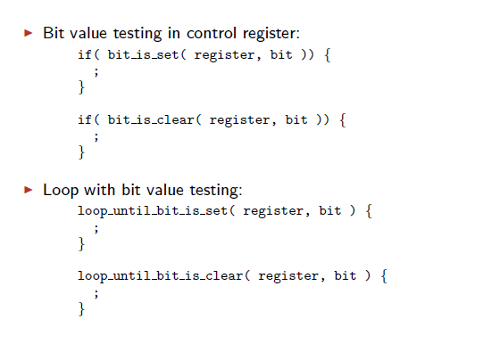
Special Functions of GCC and AVR Libc

Slide 50
Special functions - Examples
Set/Clear a Bit
// Set and Clear a Bit: using _BV
PORTB |= _BV(PB3);
PORTB &= ~_BV(PB3);
// Set and Clear a Bit: using shift operators → more readable
PORTB |= (1 << (PB3));
PORTB &= ~(1 << (PB3));
Check a bit
// If PD3 is 0 then
if (bit_is_clear(PIND,3)) ...
// If PD3 is 1 then
if (bit_is_set(PIND,3))

Slide 51
Outline
Data types and time delays in C
I/O programming in C
Logic operations in C
Data conversion programs in C
Data serialization in C
Memory allocation in C

Slide 52
One of the most important and powerful features of the C language is its ability to perform bit manipulation.
Bit-wise operators in C
While every C programmer is familiar with the logical operators AND (&&), OR (||), and NOT (!), many C programmers are less familiar with the bitwise operators AND(&), OR (|), EX-OR(^), inverter(~), shift right(>>), and shift left (<<).
These bit-wise operators are widely used in software engineering for embedded systems and control; consequently, their understanding and mastery are critical in microcontroller-based system design and interfacing. See Table 7-2.

Slide 53
Table 7-2: Bit-wise Logic Operators for C
A | B | AND | OR | XOR | NOT
 |  | A & B | A|B | A^B | Y= ~B
0 | 0 | 0 | 0 | 0 | 1
0 | 1 | 0 | 1 | 1 | 0
1 | 0 | 0 | 1 | 1 | 1
1 | 1 | 1 | 1 | 0 | 0
The following shows some examples using the C bit-wise operators:
1. 0x35 & 0x0F = 0x05 /*ANDing */
2. 0x04 | 0x68 = 0x6C /* ORing */
3. 0x54 ^ 0x78 = 0x2C /* XORing */
4. ~0x55 = 0xAA /* Inverting 55H */
Examples 7-12 through 7-20 show how the bit-wise operators are used in C. Run these programs on your simulator and examine the results.

Slide 54
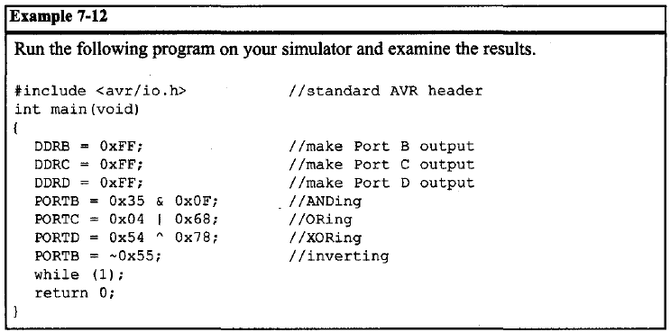

Slide 55
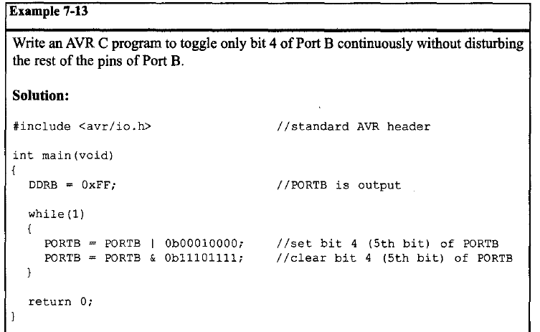

Slide 56
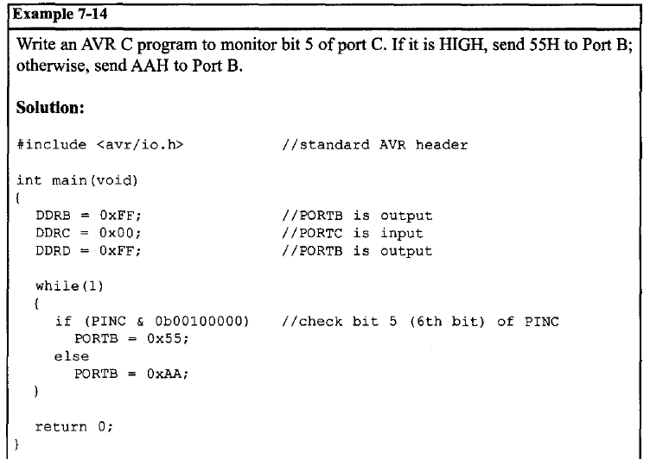

Slide 57
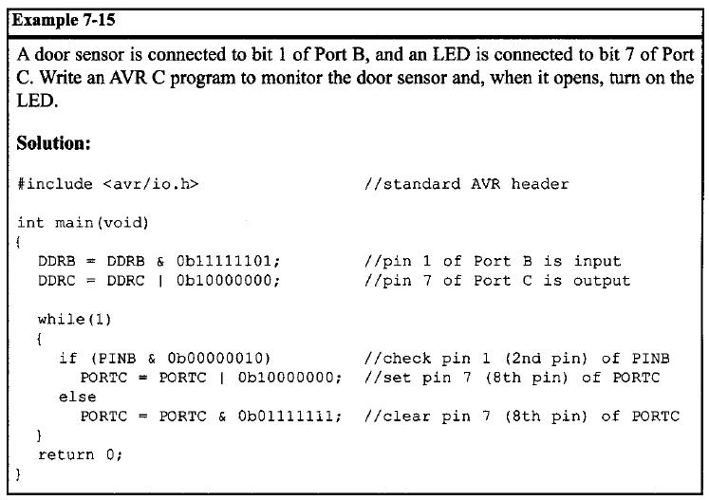

Slide 58
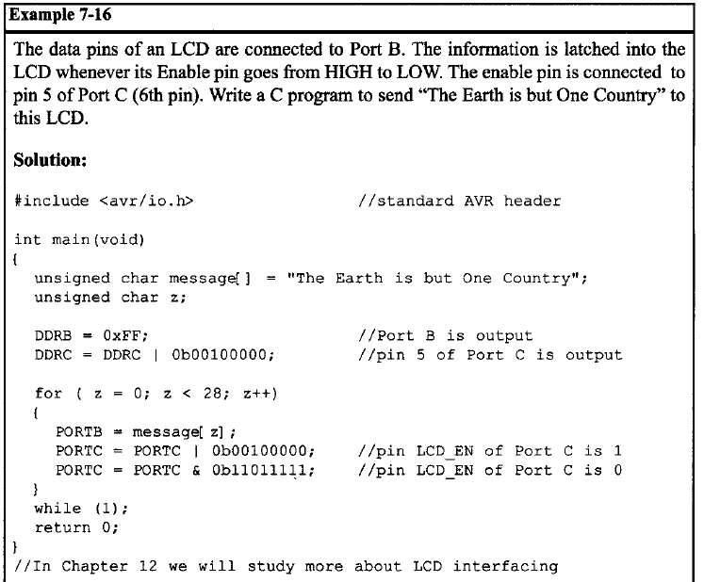

Slide 59
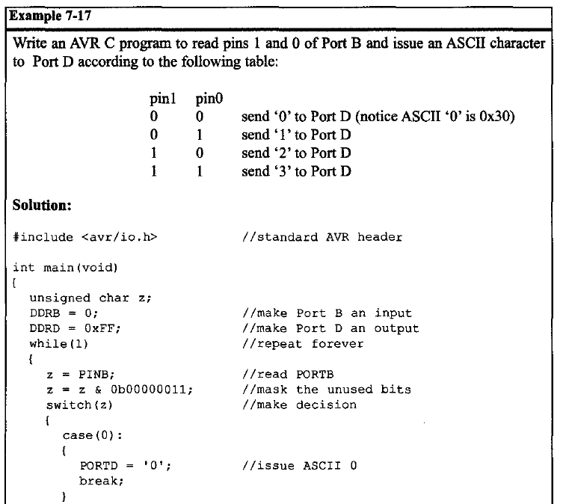

Slide 60
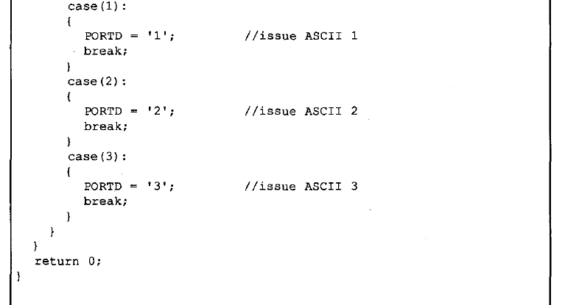
Example 7 -17 (cont.d)

Slide 61
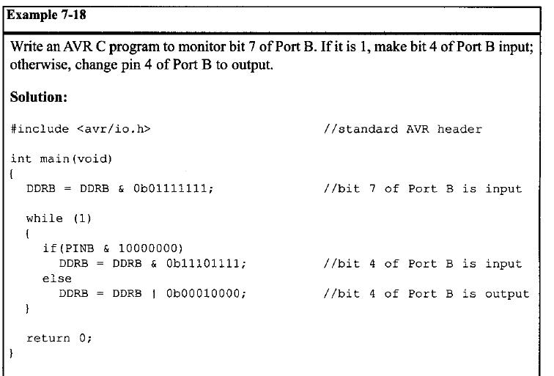

Slide 62
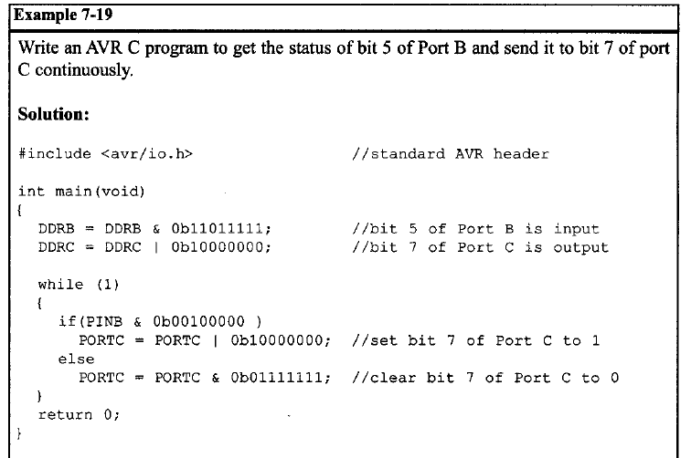

Slide 63
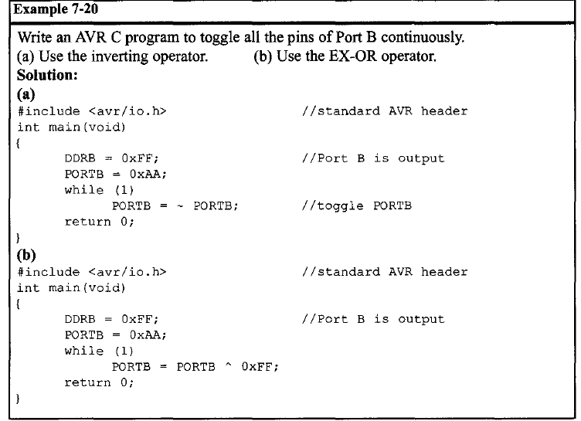

Slide 64
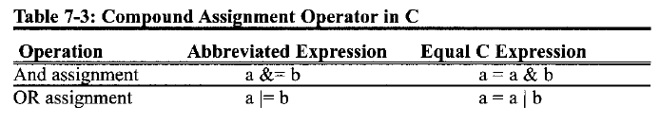
Compound assignment operators in C
To reduce coding (typing) we can use compound statements for bit-wise operators in C. See Table 7-3 and Example 7-21.

Slide 65
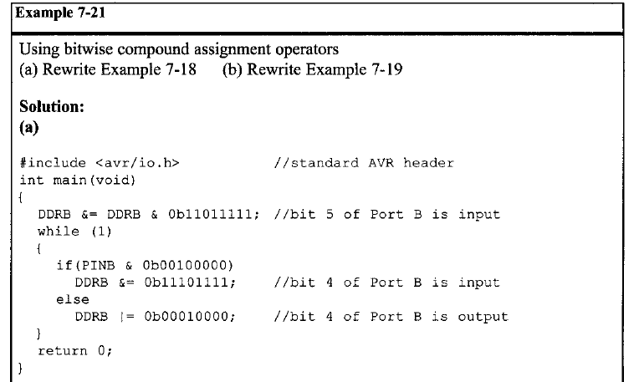

Slide 66
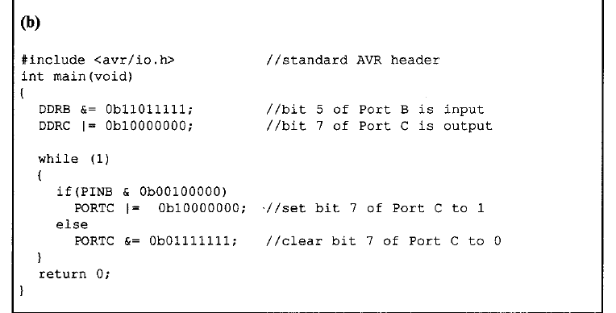
Example 7-21 (cont.d)

Slide 67
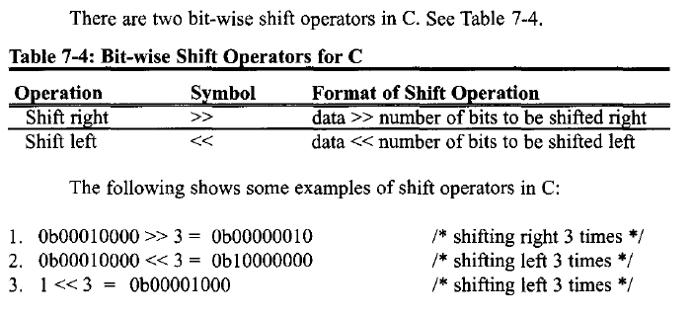
Bit-wise shift operation in C

Slide 68
Bit-wise shift operation and bit manipulation
Reexamine the last 10 examples. To do bit-wise I/0 operation in C, we need numbers like 0b00100000 in which there are seven zeroes and one one. Only the position of the one varies in different programs.
To leave the generation of ones and zeros to the compiler and improve the code clarity, we use shift operations.
For example, instead of writing “0b00100000" we can write
“0b00000001 << 5" or we can write simply “1 <<5".
Sometimes we need numbers like 0b11101111. To generate such a number, we do the shifting first and then invert it. For example, to generate 0b11101111 we can write !(1<<4). See Example 7-22.
Notice that to generate more complicated numbers, we can OR two simpler numbers. For example, to generate a number that has a one in position D7 and another one in position D4, we can OR a number that has only a one in position D7 with a number that has only a one in position D4. So we can simply write
(1 <<7)|(1 <<4).

Slide 69
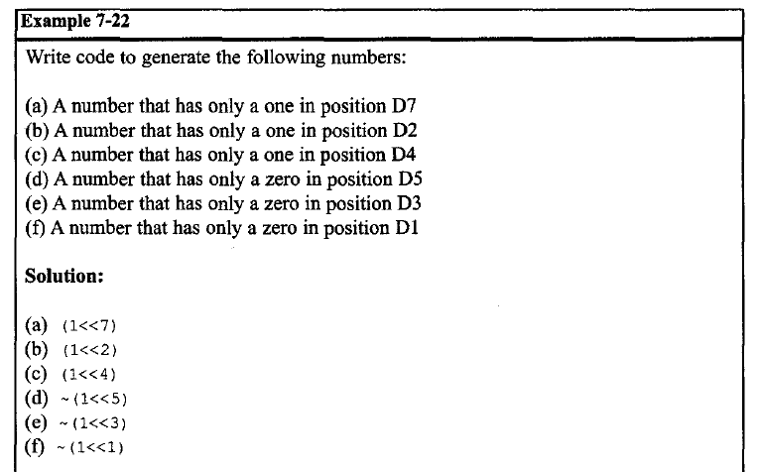

Slide 70
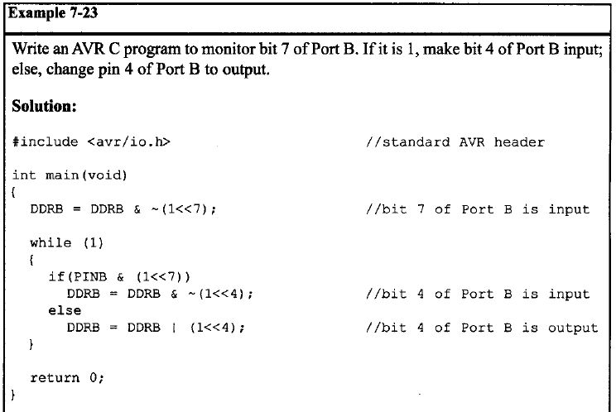

Slide 71
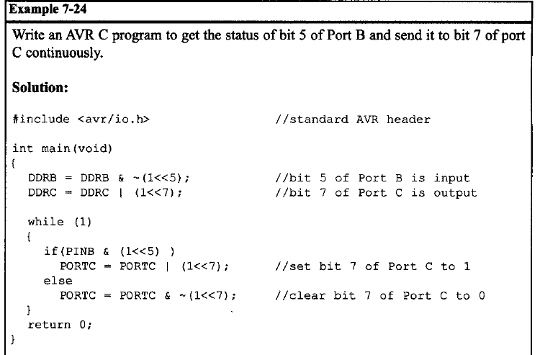

Slide 72
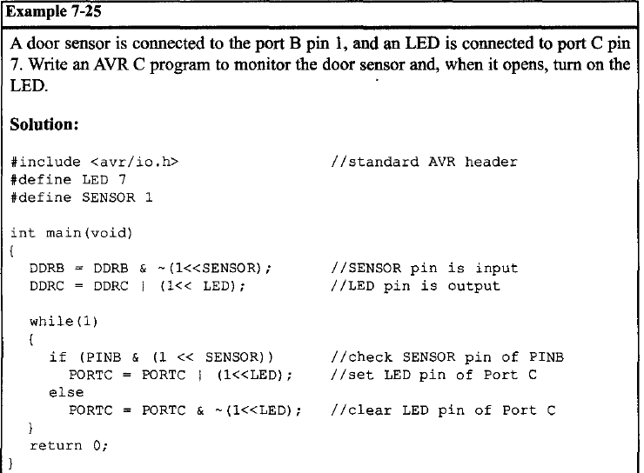

Slide 73
Outline
Data types and time delays in C
I/O programming in C
Logic operations in C
Data conversion programs in C
Data serialization in C
Memory allocation in C

Slide 74
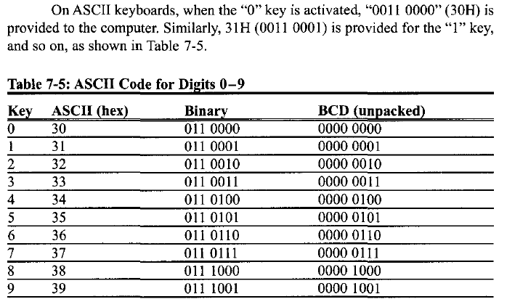
ASCII numbers

Slide 75
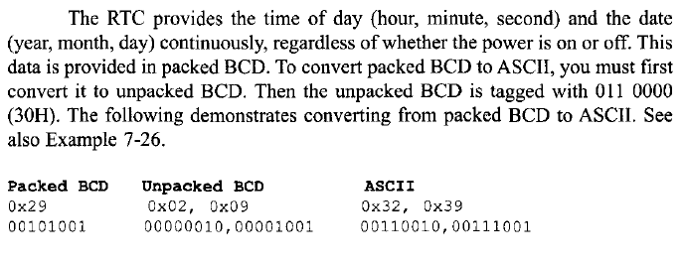
Packed BCD to ASCII conversion

Slide 76

ASCII to packed BCD conversion
To convert ASCII to packed BCD, you first convert it to unpacked BCD (to get rid of the 3), and then combine the numbers to make packed BCD. For example, 4 and 7 on the keyboard give 34H and 37H, respectively. The goal is to produce 47H or "0100 0111", which is packed BCD.

Slide 77
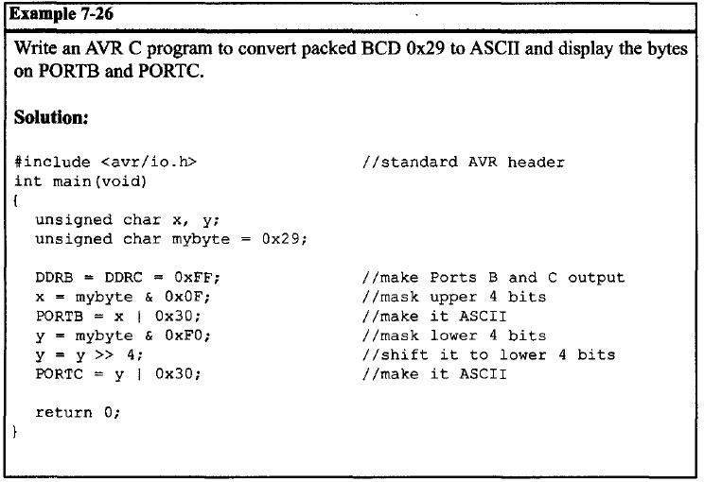

Slide 78
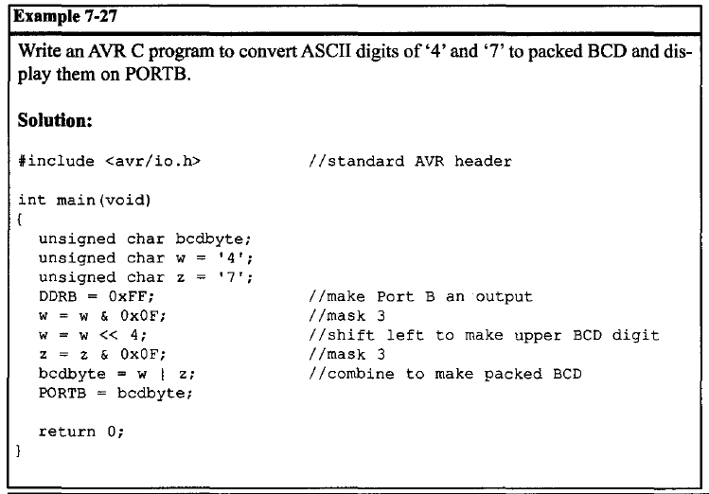
// w = 0x34 & 0x0F = 0x04
// w = 0x04 << 4 = 0x40
// z = 0x37 & 0x0F = 0x07
// bcdbyte = 0x40 | 0x07 = 0x47

Slide 79
Checksum byte in ROM
To ensure data integrity, the checksum process uses what is called a checksum byte. The checksum byte is an extra byte that is tagged to the end of a series of bytes of data. To calculate the checksum byte of a series of bytes of data, the following steps can be taken:
1. Add the bytes together and drop the carries.
2. Take the 2's complement of the total sum. This is the checksum byte, which becomes the last byte of the series.
To perform the checksum operation, add all the bytes, including the checksum byte. The result must be zero. If it is not zero, one or more bytes of data have been changed (corrupted). See Examples 7-28 through 7-30.

Slide 80
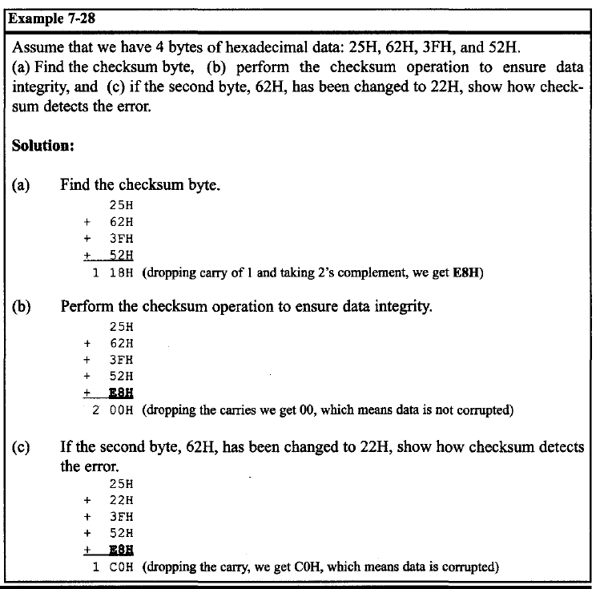

Slide 81
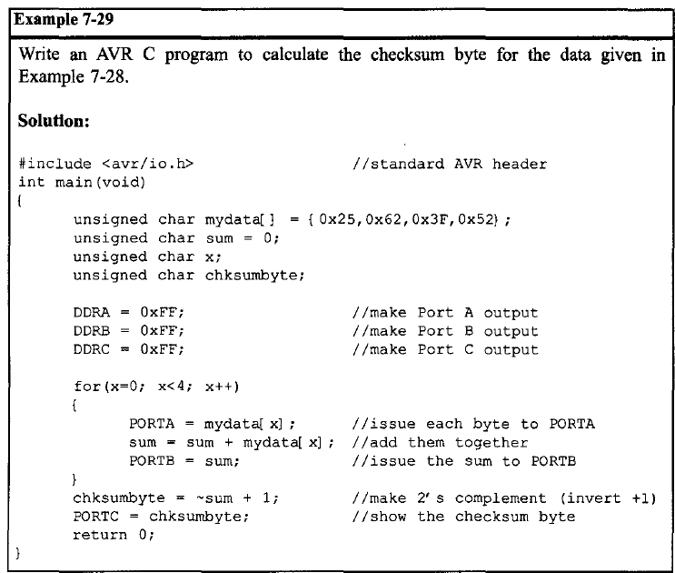

Slide 82
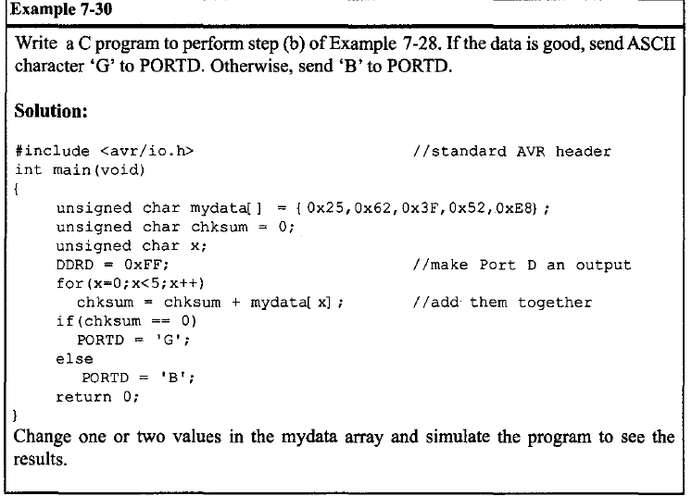
// G means Good
// B means Bad

Slide 83
Binary (hex) to decimal and ASCII conversion in C
The printf function is part of the standard I/0 library in C and can do many things including converting data from binary (hex) to decimal, or vice versa. But printf takes a lot of memory space and increases your hex file substantially. For this reason, in systems based on the AVR microcontroller, it is better to know how to write our own conversion function instead of using printf.
One of the most widely used conversions is binary to decimal conversion (used for ADC, RTC, ....). In order to display binary data, we need to convert it to decimal and then to ASCII. Because the hexadecimal format is a convenient way of representing binary data, we refer to the binary data as hex. The binary data 00-FFH converted to decimal will give us 000 to 255. One way to do that is to divide it by 10 and keep the remainder, as was shown in Chapters 5 and 6.

Slide 84
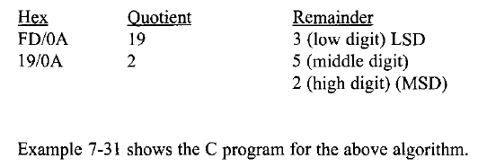
Binary (hex) to decimal and ASCII conversion in C
For example, 11111101 or FDH is 253 in decimal. The following is one version of an algorithm for conversion of hex (binary) to decimal:

Slide 85
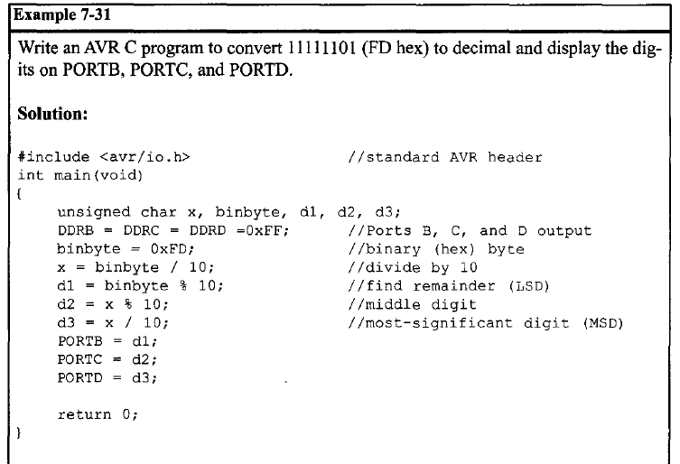

Slide 86
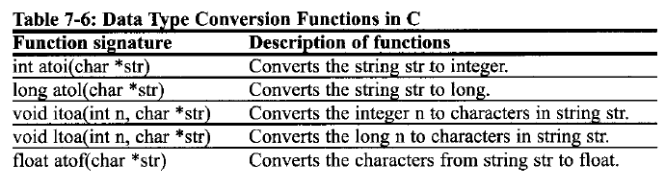
Data Type Conversion Functions in C
Many compilers have some predefined functions to convert data types. In Table 7-6 you can see some of them. To use these functions, the stdlib.h file should be included. Notice that these functions may vary in different compilers

Slide 87
Outline
Data types and time delays in C
I/O programming in C
Logic operations in C
Data conversion programs in C
Data serialization in C
Memory allocation in C

Slide 88
Data serialization in C
Serializing data is a way of sending a byte of data one bit at a time through a single pin of a microcontroller. There are two ways to transfer a byte of data serially:
1. Using the serial port. In using the serial port, the programmer has very limited control over the sequence of data transfer. The details of serial port data transfer are discussed in Chapter 11.
2. The second method of serializing data is to transfer data one bit a time and control the sequence of data and spaces between them. In many new generations of devices such as LCD, ADC, and EEPROM, the serial versions are becoming popular because they take up less space on a printed circuit board. Although we can use standards such as PC, SPI, and CAN, not all devices support such standards. For this reason we need to be familiar with data serialization using the C language.

Slide 89
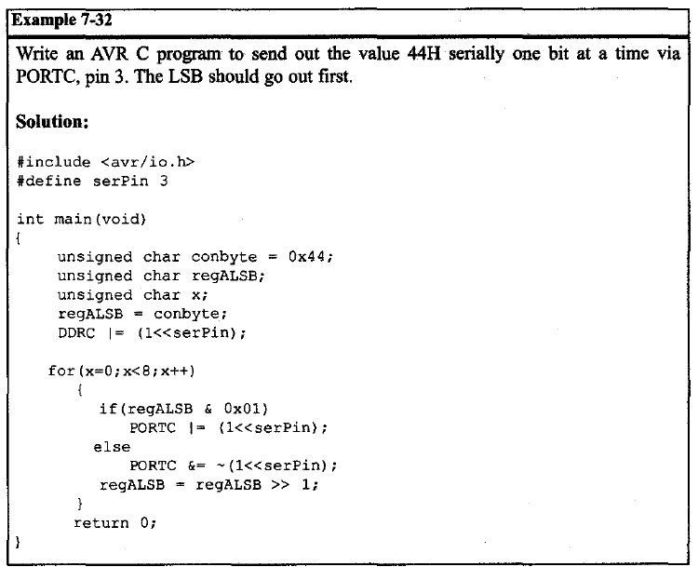

Slide 90


Slide 91


Slide 92


Slide 93
Outline
Data types and time delays in C
I/O programming in C
Logic operations in C
Data conversion programs in C
Data serialization in C
Memory allocation in C

Slide 94
Flash, RAM, and EEPROM data space in the AVR (1/2)
In the AVR we have three spaces in which to store data. They are as follows:
1. The 64K bytes of SRAM space with address range 0000-FFFFH. As we have seen in previous chapters, many AVR chips have much less than 64K bytes for the SRAM. We also have seen how we can read (from) or write (into) this RAM space directly or indirectly. We store temporary variables in SRAM since the SRAM is the scratch pad.
2. The 2M words (4M bytes) of code (program) space with addresses of 000000-1FFFFFH. This 2M words of on-chip Flash ROM space is used primarily for storing programs (opcodes) and therefore is directly under control of the program counter (PC). As we have seen in the previous chapters, many AVR chips have much less than 2M words of on-chip program ROM (see Table 7-7). We have also seen how to access the program space for the purpose of data storage (see Chapter 6).

Slide 95

Flash, RAM, and EEPROM data space in the AVR (2/2)
3. EEPROM. As we mentioned before, EEPROM can save data when the power is off. That is why we use EEPROM to save variables that should not be lost when the power is off. For example, the temperature set point of a cooling system should be changed by users and cannot be stored in program space. Also, it should be saved when the power is off, so we place it in EEPROM. Also, when there is not enough code space, we can place permanent variables in EEPROM to save some code space.
To define a variable in EEPROM, you can put the eeprom directive in front of it:
flash unsigned char mynum[] = "Hello"; //use Flash code space
eeprom unsigned char = 7; //use EEPROM space

Slide 96


Slide 97


